Slide 1
The Theory of Consumer Choice
Chapter-21
Course: Microeconomics
Faculty
United Int. University

Slide 2
Consumer Choice
As we have seen, the demand curve for a good reflects consumers’ willingness to pay for that good. When the price rises, consumers are willing to pay for fewer units, so the quantity demanded falls.
One of the Ten Principles of Economics discussed in Chapter 1 is that people face trade-offs. The theory of consumer choice examines the trade-offs that people face in their role as consumers.
When a consumer buys more of one good, he can afford less of other goods. When he spends more time enjoying leisure and less time working, he has lower income and can afford less consumption. When he spends more of his income in the present and saves less of it, he must accept a lower level of consumption in the future.

Slide 3
THE BUDGET CONSTRAINT: WHAT THE CONSUMER CAN AFFORD
The theory of consumer choice examines how consumers facing these trade-offs make decisions and how they respond to changes in their environment.
People consume less than they desire because their spending is constrained, or limited, by their income.
Budget constraint-the limit on the consumption bundles that a consumer can afford.
Bundles : a particular combination of two or more goods.
The slope of the budget constraint measures the rate at which the consumer can trade one good for the other.
The slope of the budget constraint equals the relative price of the two goods—the price of one good compared to the price of the other.

Slide 4
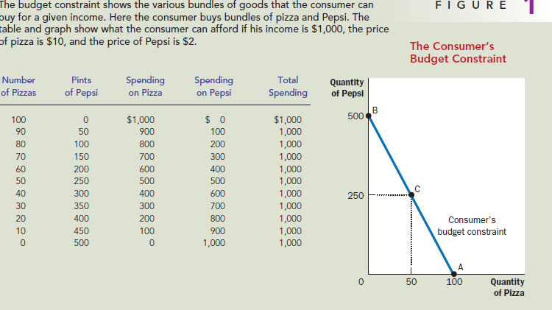
THE BUDGET CONSTRAINT: WHAT THE CONSUMER CAN AFFORD

Slide 5
REPRESENTING PREFERENCES WITH INDIFFERENCE CURVES
The consumer’s preferences allow him/her to choose among different bundles of goods.
If the two bundles suit his/her tastes equally well, we say that the consumer is indifferent between the two bundles. Ex-Pasta & Pizza
Indifference curve-a curve that shows consumption bundles that give the consumer the same level of satisfaction.
Marginal rate of Substitution- the rate at which a consumer is willing to trade one good for another.

Slide 6
FOUR PROPERTIES OF INDIFFERENCE CURVES
Property 1: Higher indifference curves are preferred to lower ones. People usually prefer to consume more goods rather than less.
Property 2: Indifference curves are downward sloping. The slope of an indifference curve reflects the rate at which the consumer is willing to substitute one good for the other. In most cases, the consumer likes both goods. Therefore, if the quantity of one good is reduced, the quantity of the other good must increase for the consumer to be equally happy. For this reason, most indifference curves slope downward.

Slide 7
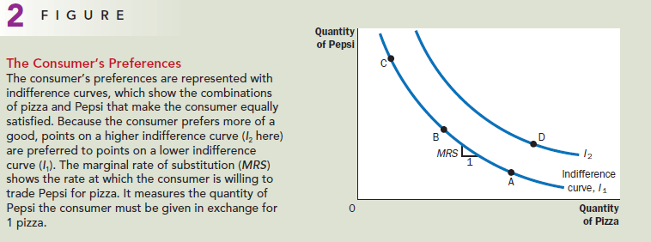
FOUR PROPERTIES OF INDIFFERENCE CURVES

Slide 8
FOUR PROPERTIES OF INDIFFERENCE CURVES
Property 3: Indifference curves do not cross. To see why this is true, suppose that two indifference curves did cross, as in Figure 3. Then, because point A is on the same indifference curve as point B, the two points would make the consumer equally happy. In addition, because point B is on the same indifference curve as point C, these two points would make the consumer equally happy. But these conclusions imply that points A and C would also make the consumer equally happy, even though point C has more of both goods. This contradicts our assumption that the consumer always prefers more of both goods to less. Thus, indifference curves cannot cross.

Slide 9
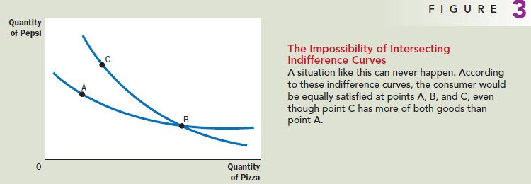
FOUR PROPERTIES OF INDIFFERENCE CURVES

Slide 10
FOUR PROPERTIES OF INDIFFERENCE CURVES
Property 4: Indifference curves are bowed inward. The slope of an indifference curve is the marginal rate of substitution—the rate at which the consumer is willing to trade off one good for the other. The marginal rate of substitution (MRS) usually depends on the amount of each good the consumer is currently consuming. In particular, because people are more willing to trade away goods that they have in abundance and less willing to trade away goods of which they have little, the indifference curves are bowed inward.

Slide 11
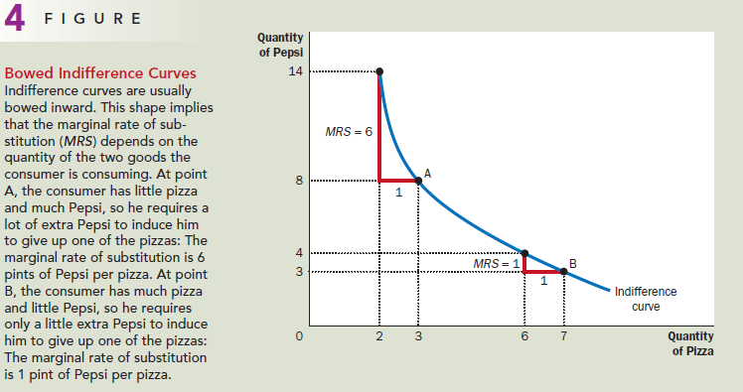
FOUR PROPERTIES OF INDIFFERENCE CURVES

Slide 12
TWO EXTREME EXAMPLES OF INDIFFERENCE CURVES
Perfect substitutes- two goods with straight line indifference curves. Because the marginal rate of substitution is constant, the indifference curves are straight lines. Exchange ratio 1:1. Ex- One pasta for one pizza
Perfect complements- two goods with right angle indifference curves. Ex- Left Shoe & right shoe

Slide 13
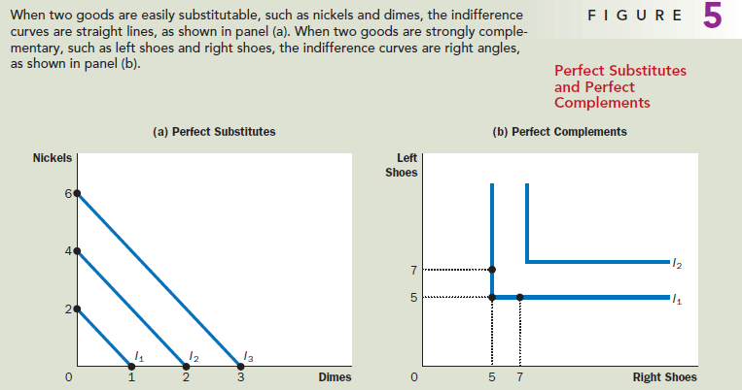
TWO EXTREME EXAMPLES OF INDIFFERENCE CURVES

Slide 14
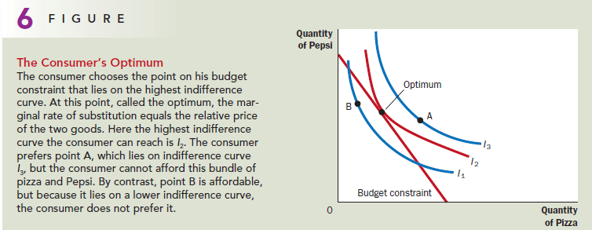
OPTIMIZATION: THE CONSUMER’S OPTIMAL CHOICES

Slide 15
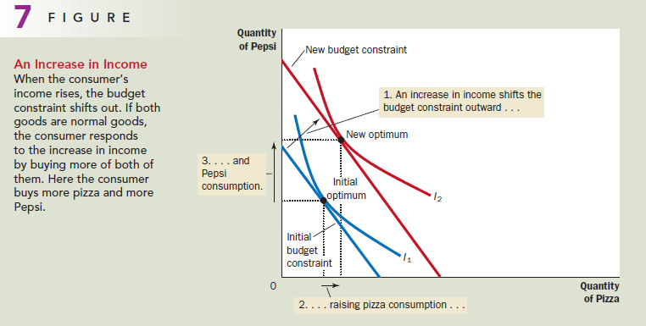
HOW CHANGES IN INCOME AFFECT THE CONSUMER’S CHOICES

Slide 16
HOW CHANGES IN PRICES AFFECT THE CONSUMER’S CHOICES
Inferior good

Slide 17
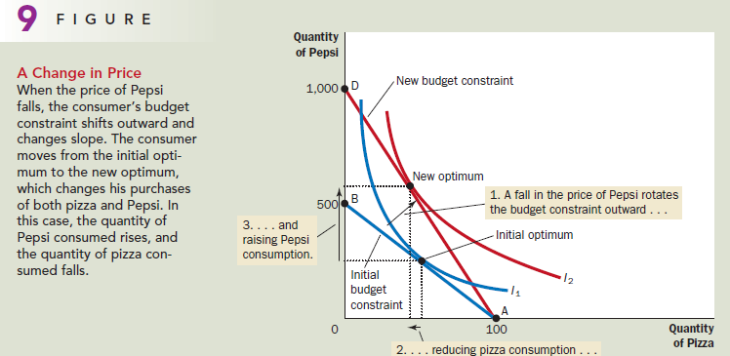
HOW CHANGES IN PRICES AFFECT THE CONSUMER’S CHOICES

Slide 18
Deriving the Demand Curve

Slide 19
Do All Demand Curves Slope Downward?
Normally, when the price of a good rises, people buy less of it according to the law of demand, and is reflected in the downward slope of the demand curve.
As a matter of economic theory, however, demand curves can sometimes slope upward. In other words, consumers can sometimes violate the law of demand and buy more of a good when the price rises.
Giffen good- a good for which an increase in the price raises the quantity demanded

Slide 20
Do All Demand Curves Slope Downward?

Slide 21
The Consumption-Saving Decision

